Slide 1
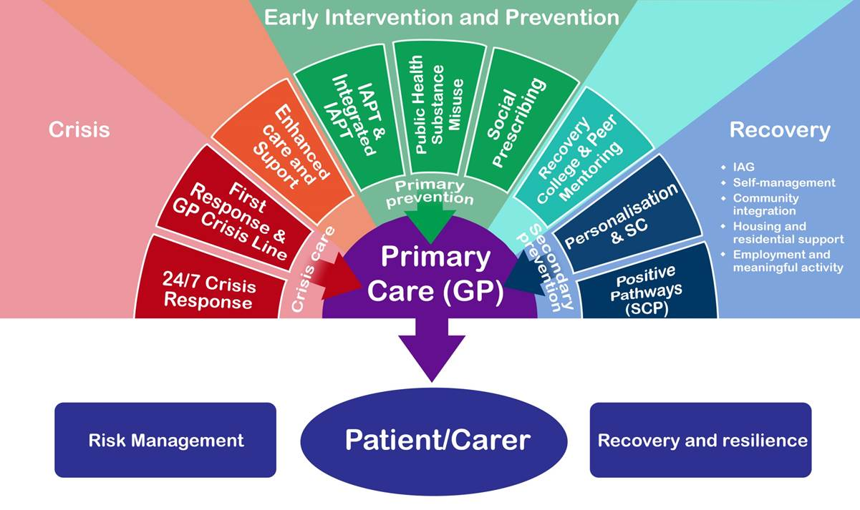
Thurrock Enhanced Primary Care Model Working in Partnership
Insert other partners

Slide 2
Agenda
Notes:
Thank you for allowing me to come and talk to you today, my name is Jo and I want to talk to you a bit about how we are proposing to transform mental health services in Thurrock.
Firstly, I would like to introduce you to Toni who is a Thurrock resident and going to talk a little bit about her experiences with mental health service…………….
Thank you Toni for sharing your experience with us, I know that all of us have had either personal experience of going through mental health services or know someone that has. This is why it is so important for us to get this right in future and why I am here today

Slide 3
Aims and Objectives
A Thurrock Project Team has been set up to oversee local mental health transformation programmes in Thurrock
The intention is for all providers of mental health services to work together to provide a consistent pathway with the following aims and benefits;
Early intervention targeted when conditions occur
Preventing serious conditions getting worse through providing help earlier
Care closer to home
Combining mental heath care and physical health care
Support provided in the community when released from acute care
Notes:
Slide 1 – Aims and Objectives
A project team has been set up to create a better and more sustainable mental health service starting in Thurrock.
All providers are jointly working together to create a better and more consistent pathway to create individual care.
The aims of this are to:
Intervene at an earlier stage as soon as a condition or issue occurs
Preventing people from getting worse by providing help sooner
Care closer to home so individuals do not need to travel long distances or try to get transport when feeling unwell
Combining mental health with physical conditions, often we know that those with long term condition are more likely to have a mental health condition also
Support for those who have been release from care and need support in the community to stay well.

Slide 4
Reasons for Change
Mental health is complicated and various health and social issues can contribute to ill health.
Individuals are currently going to different professionals to address different needs such as emotional, social and physical.
Those with various issues can be passed around the system delaying treatment and care
Current system is disconnected and individuals are asked to repeat themselves several times to different professionals.
Delays in treatment could make conditions worse
Notes:
Slide 2 – Reason for Change
As we know Mental health is complicated and there are many factors that could contribute, some of these could be housing difficulties, having a long term condition, finding a job or loneliness
We know that individuals are going to multiple professionals to address these individual needs.
People are also being passed around the system to see multiple professionals which delays treatment and repeating themselves several times.
This delay in treatment can make matters worse

Slide 5
Why We Are Proposing a New Model
Those needing support are seen by the right person, at the right time and in the right place.
All providers will work together to ensure all needs are met
Early Intervention and prevention – Promoting good mental health and preventing poor mental health
Improving urgent and emergency care – crisis response and care
Parity of esteem and care closer to home – integrating social care, mental health, and physical health
Waiting times reduced
More self help to assist individuals to manage their condition better
Notes:
Slide 3 – So these are some of the reason why we are choosing a new model
So people can see the right person, in the right place at the same time
Preventing ill health earlier and promoting good mental health
Improving urgent care such as crisis response
Integrating services so all needs are met weather is be social, psychological or physical
By doing so we hope to reduce waiting times for care and support
And provide self-help in the community

Slide 6
National Drivers
Health and Social Care Act (2012)
Urgent and Emergency Care Review (2013)
Achieving Better Access to MH services by 2020 (2014)
Five Year Forward View for Mental Health (2014)
Mental Health Crisis Care Concordat (2014)
Right Here, Right Now (CQC report, 2015)
Policing and Crime Act (2017)
NHS Planning Guidance (2017)
Mental Health Act Review (2018)
The Long Term NHS Plan (2018)
Notes:
Slide 4 – As well as and most importantly to improve the experience and health of individuals, this work is supported by a system wide move to transform services to make them sustainable. Such as the 5 year forward view and the long term plan.
This aims to join up professions to work together to create services which wrap around the needs of an individual and providing services within a community based setting. Joining prevention, primary care and acute services to give individualised care.
It has never been more real, I know you must have heard things are changing previously, however this has been the first time that there has been a clear shift to change and the money provided to do so

Slide 7
Local Strategy
Through strong leadership and innovative transformation, engagement with local people to deliver an integrated health, social care, physical and mental health service to improve lives
Notes:
I have already touched on this; however it is crucial that we transform service with all people involved to improve lives.

Slide 8
Local Need
Social Care
Crisis
PD – Personality Disorder
Substance Misuse
SMI – Serious Mental Illness
IPS -Individual Placement and Support
Forensic Support
Transitions
Mental Health Medicine
Physical Health
Notes:
We know in Thurrock we need social care, crisis support, services for personality disorders, substance misuse, Support for serious mental illness, transitions between services medicines and so on.

Slide 9
Local Vision
Improving urgent and emergency care mental health – crisis response and care.
Integrating social care, mental health and physical health – parity of esteem and care closer to home.
Promoting good mental health and preventing poor mental health – early intervention and prevention.
Notes:
So this is the Thurrock local vision and we call this the rainbow chart, and this shows the support a person will get and from various services working together at every stage of illness from early intervention and prevention to when in crisis and support all the way back to recovery.

Slide 10
Thurrock Enhanced Primary Care Team
Abbreviation | Meaning
LAC | Local Area Coordinator
IPS | Individual Placement and Support
IAPT | Improving Access to Psychological Therapies
PD (STEPPS) | Personality Disorder – Systems Training for Emotional Predictability and Problem Solving
Notes:
So this is the proposal we have put together, this will be a service based within the community, this could be a health hub a GP practice or somewhere else. Where all providers of services will come in to the service, someone will identify all needs in the one place and partners will work as a team to identify all the services that person requires in the one place.
This could include a social worker, someone to look at their housing needs and of course mental health professionals.

Slide 11
Benefits
People will live longer
People will have less time of their life living with a long term condition
People will have more choice in easy to access services to meet their needs
More local services, care and support at home and not in hospital
24hour 7 day a week treatment, care and support
Notes:
This will help people live longer due to better health, and less time living with a long term condition, more choice of services they need and more local to them and being a 24 hour 7 days a week treatment and care.

Slide 12
IPCMH Future Model - Thurrock Locality Governance
Notes:
very quickly this is the governance structure of those working with and for this project, and as you can see this group feeds directly into the project group, however this is not exclusive on the group work you will see we have asked you how you would like to be involved and if you would like to you can be part of a sub group feeding into this or part of the project group if you are a Thurrock resident at this moment in time.

Slide 13
Group Work Discussion
What is your experience of the service?
What do you think of the proposed new model?
What is most important to you?
What have we missed?
Also
Would you like to be involved in the process?
If so, how would you like to be involved?
Notes:
Please take a look at the questions and we would love your thoughts, if you would like to sit in groups and go through the questions this would be great if you would prefer to write you comments on the piece of paper and hand it in at the end that is also fine.
We will have some quick feedback at the end, please feel free to ask me any questions and I will also be around after if you wanted to have a chat with me.

